Slide 1


Slide 2
Pandas

Slide 3
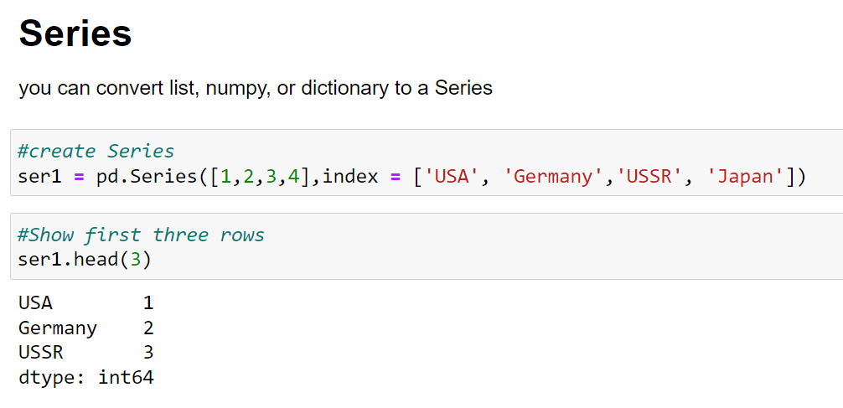
Pandas

Slide 4
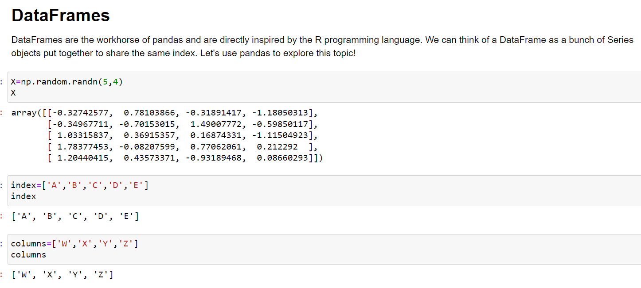
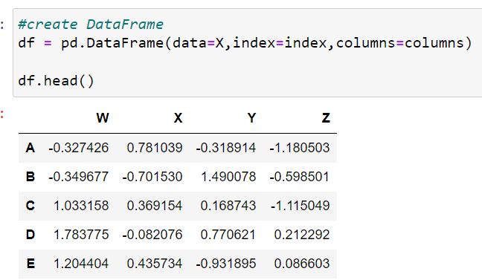
Pandas

Slide 5
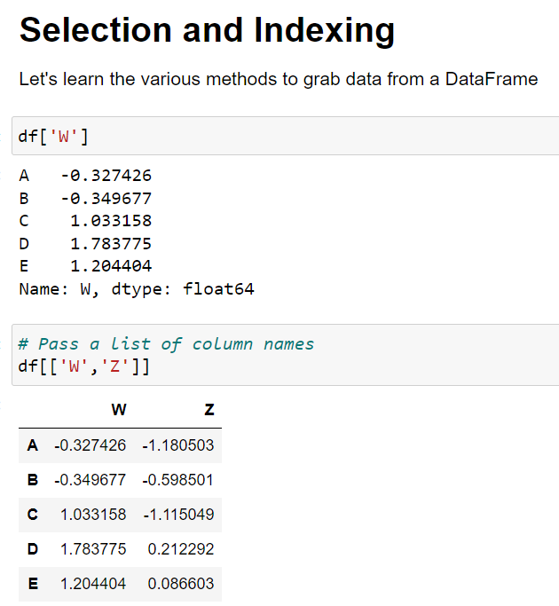
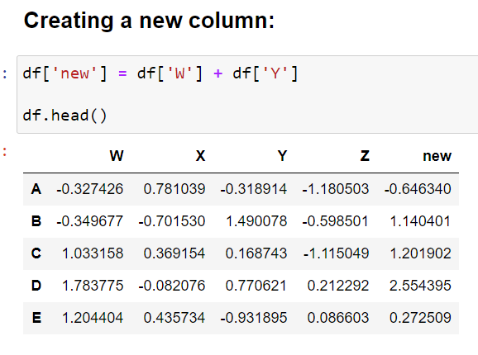
Pandas

Slide 6
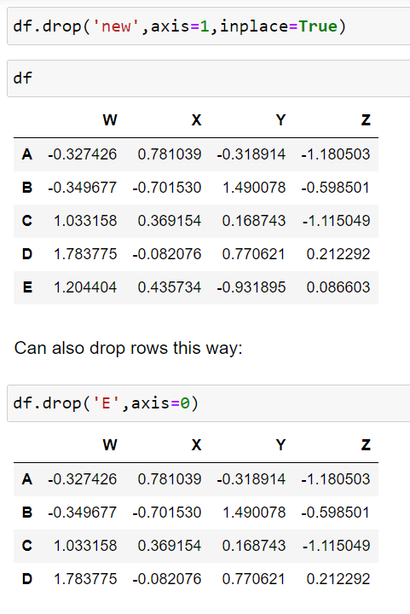
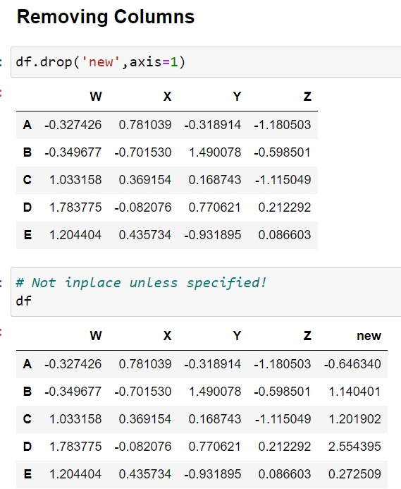
Pandas

Slide 7
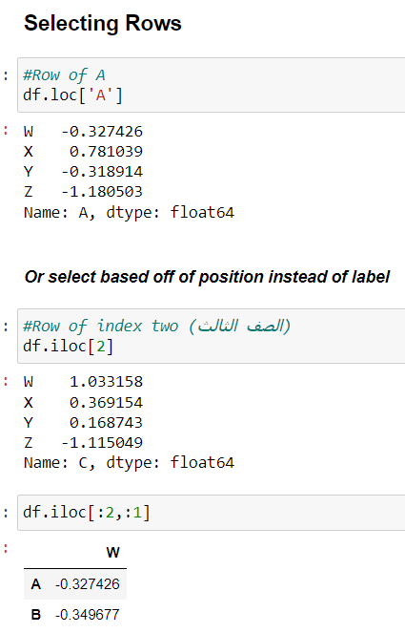
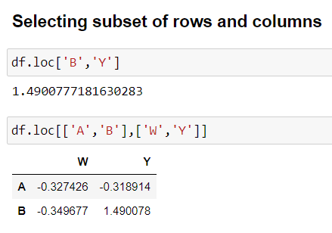
Pandas

Slide 8
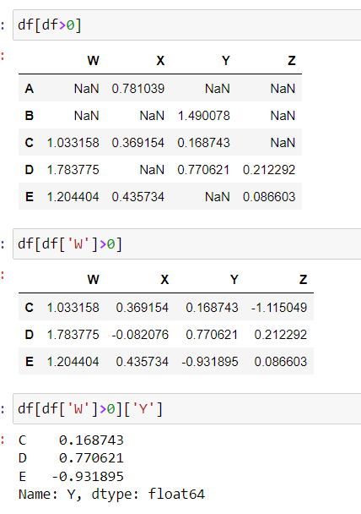
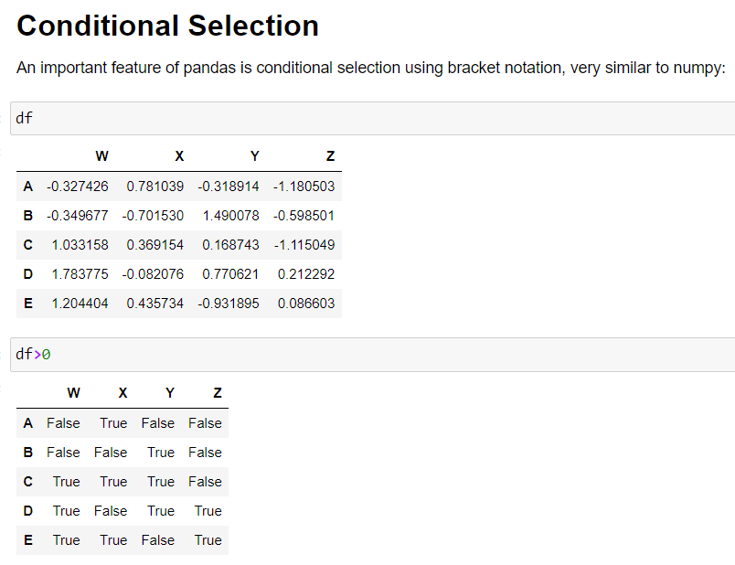
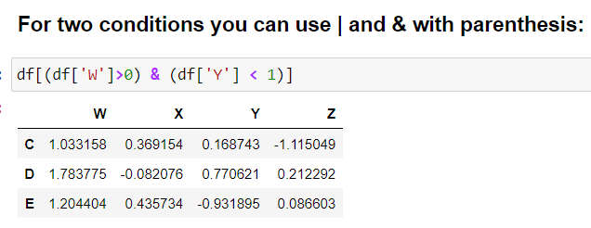
Pandas

Slide 9
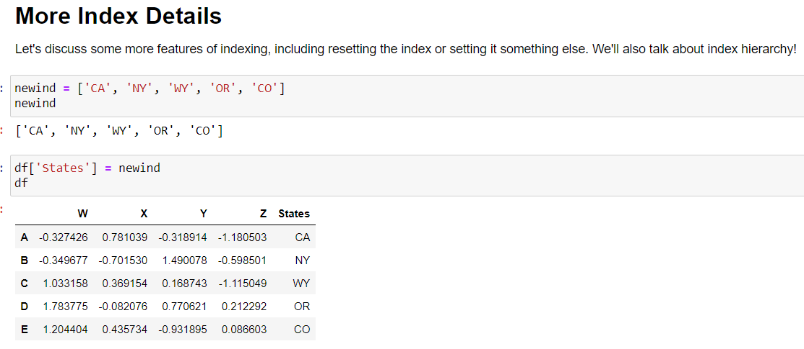
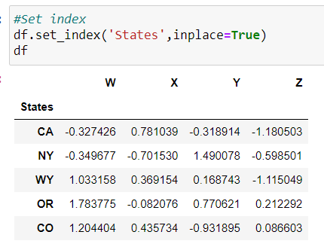
Pandas

Slide 10
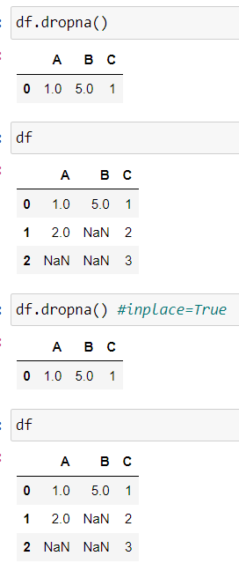
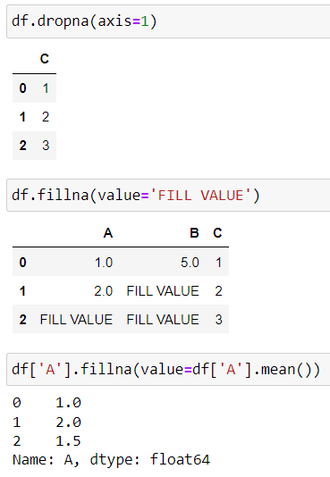
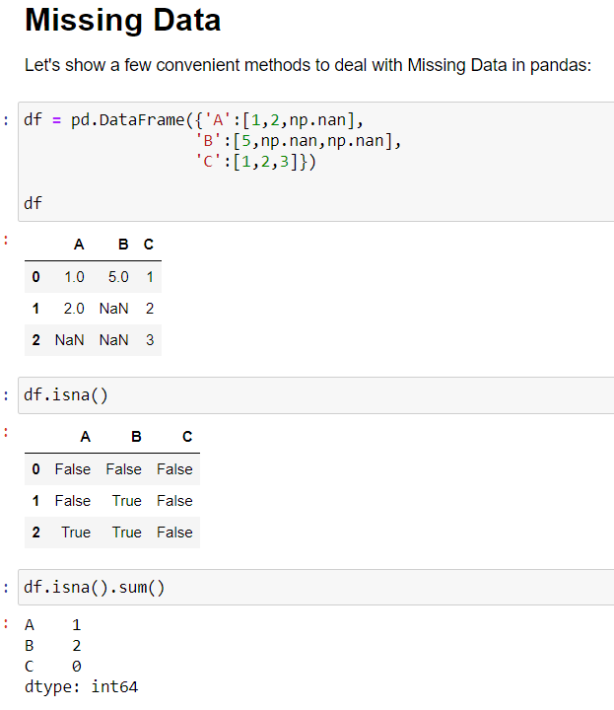
Pandas

Slide 11
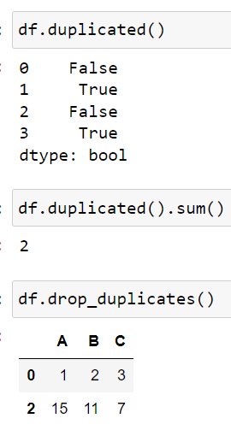
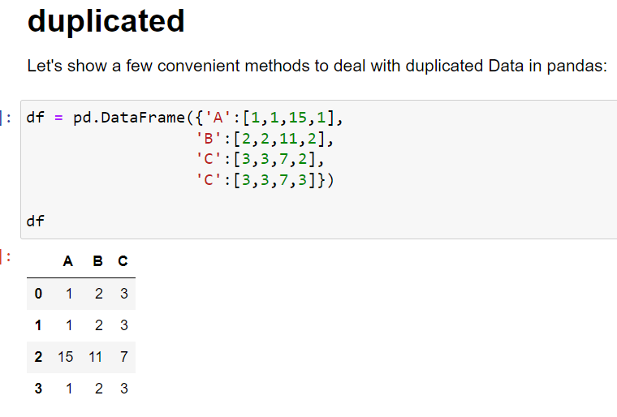
Pandas

Slide 12
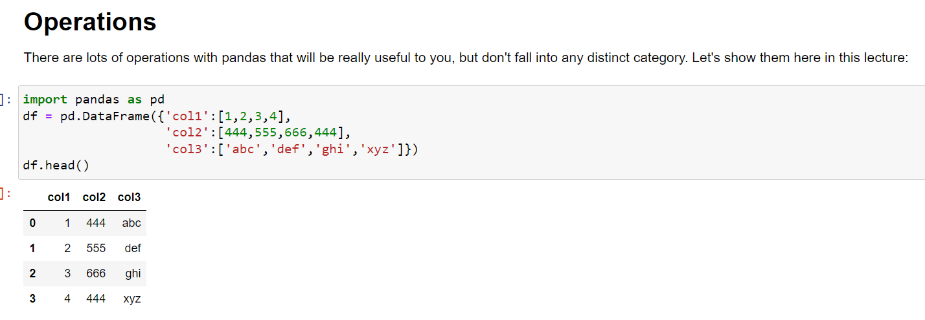
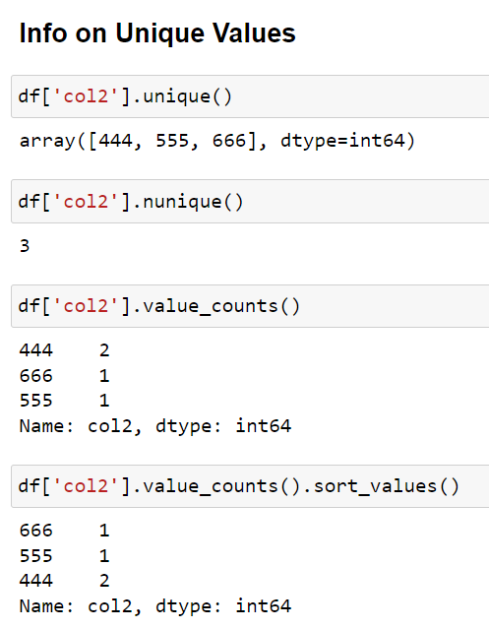
Pandas

Slide 13
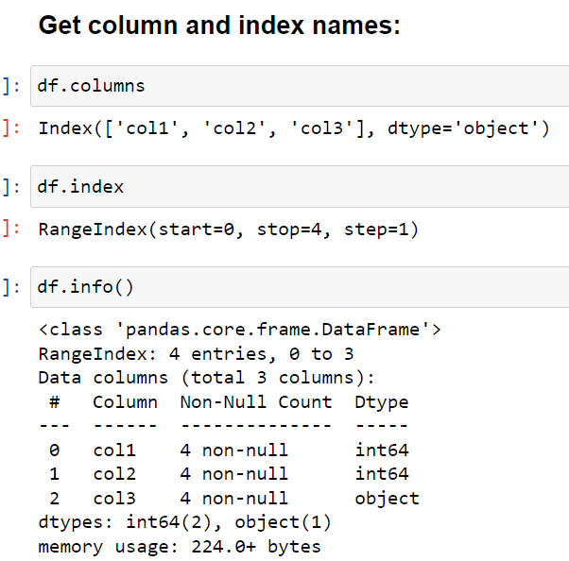
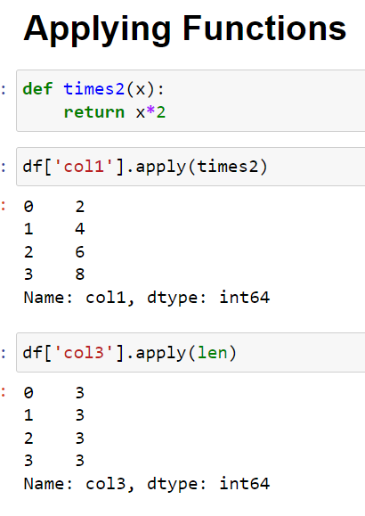
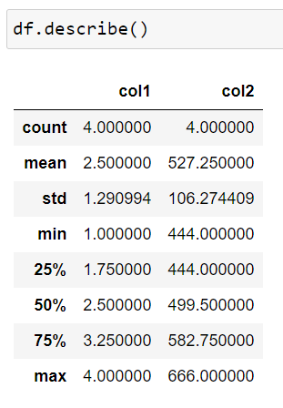
Pandas

Slide 14
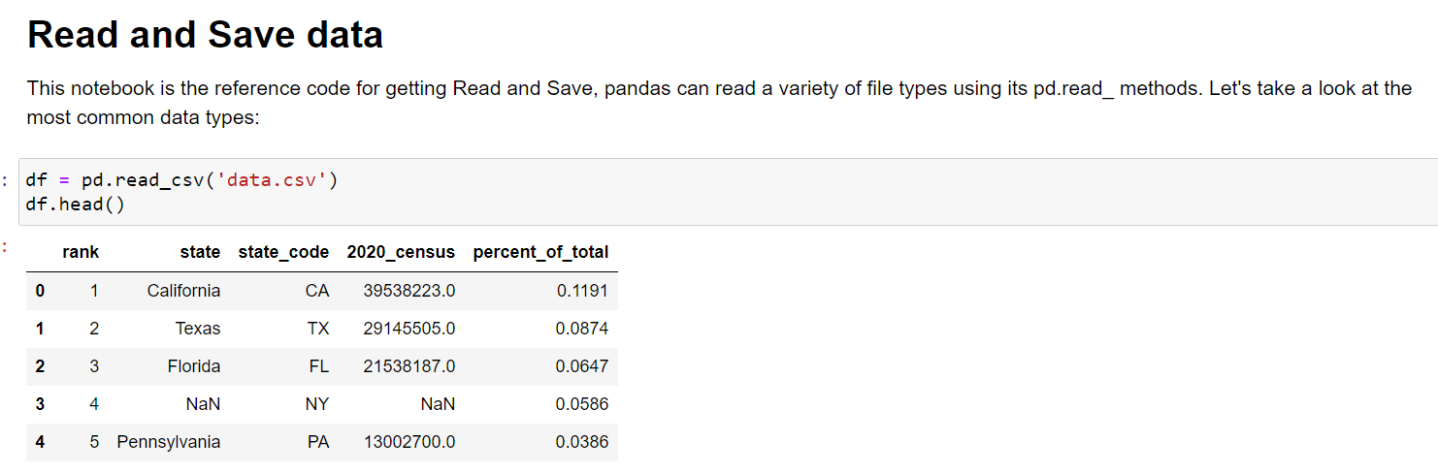
Pandas

Slide 15
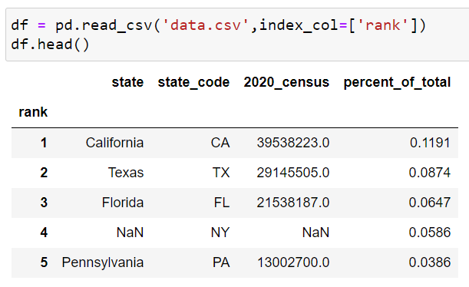
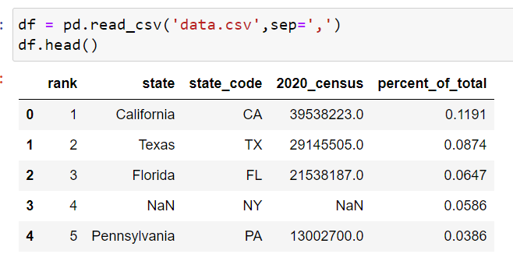
Pandas

Slide 16
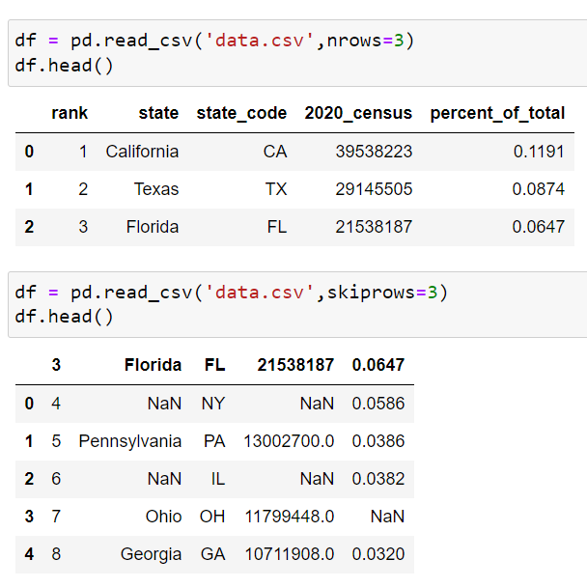
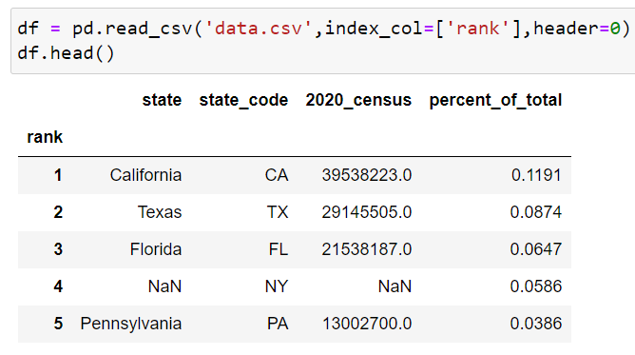
Pandas

Slide 17
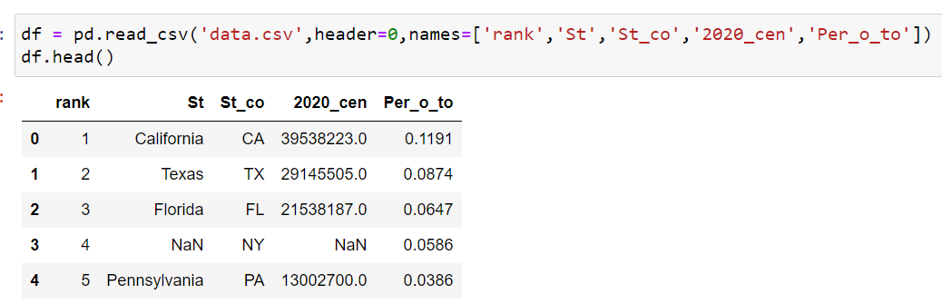
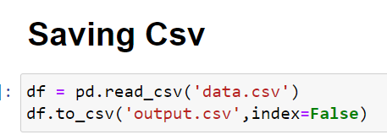
Pandas

Slide 18
matplotlib

Slide 19
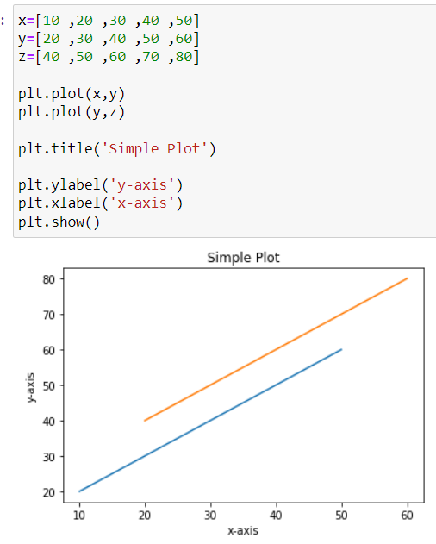
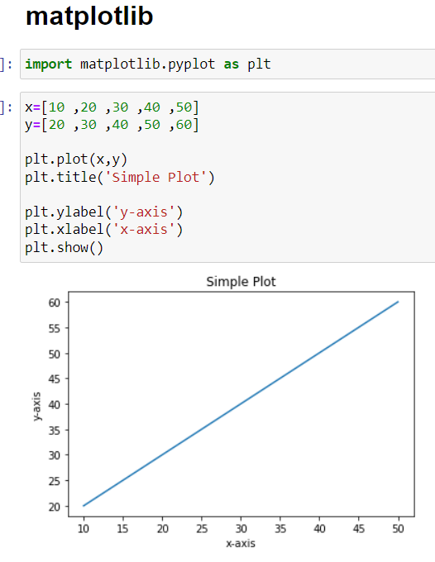
matplotlib

Slide 20
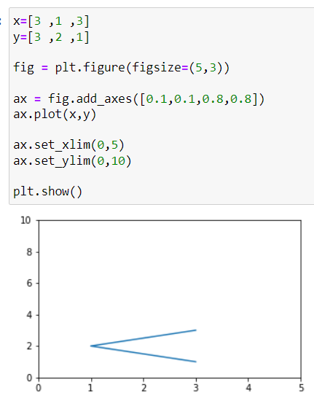
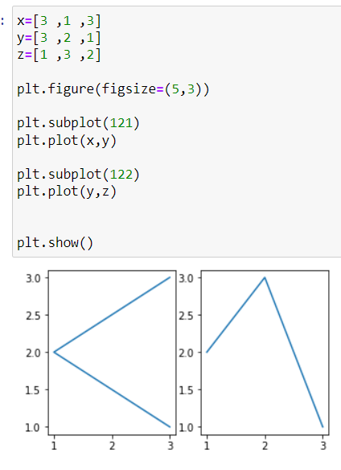
matplotlib

Slide 21
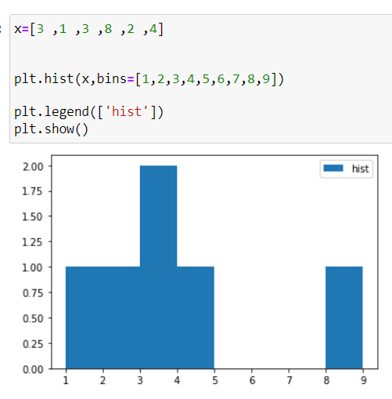
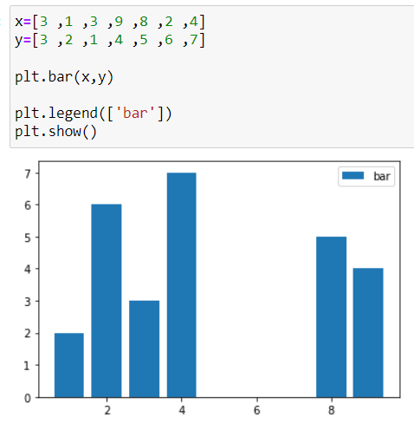
matplotlib

Slide 22
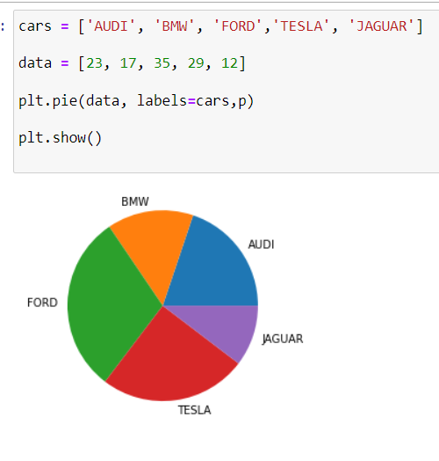
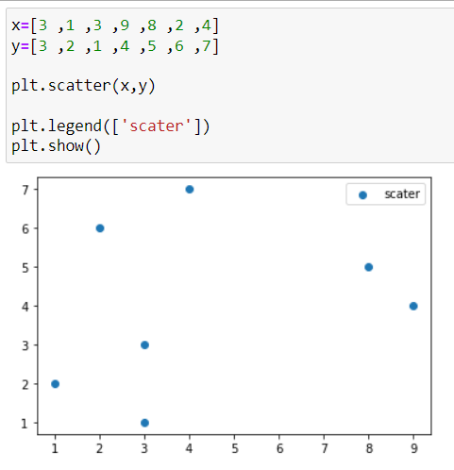
matplotlib

Slide 23
Machine learning
Introduction

Slide 24



What is machine learning
Model
Data
Learn a Task
Don’t tell me if-then rules, Just give me the data and I will learn the task

Slide 25
Types of machine learning: (1) Supervised Learning
Input
Output
Input and output are known
The model learns the relationship between input and output

Slide 26
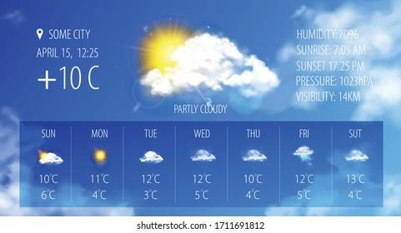
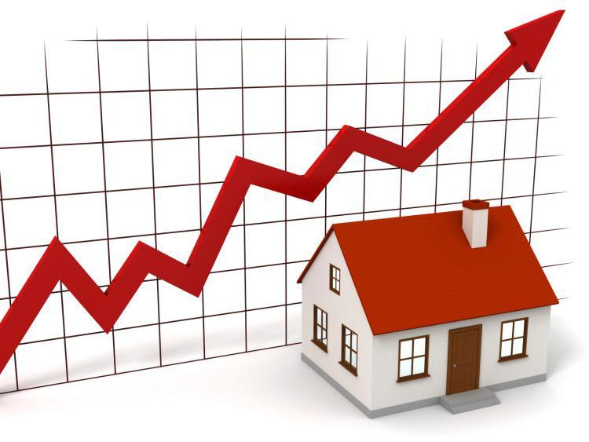

Supervised Learning Examples:
Regression
Predicting Stock Market Changes
Predicting temperature
Predicting House Prices

Slide 27
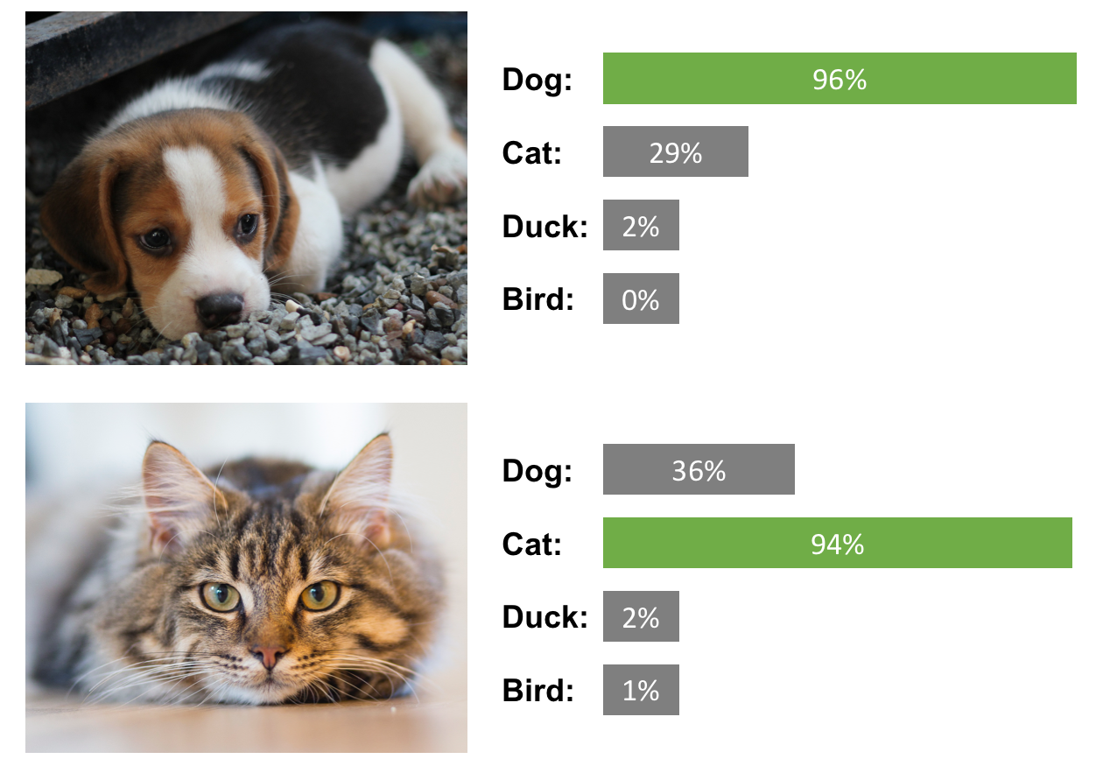


Supervised Learning Examples:
Classification
Medical diagnosis (disease classification)
Email classification (Spam/not spam)
Image classification

Slide 28
Types of machine learning: (2) Unsupervised Learning
Input
Output
Only Input is known
The model performs a task with the input such as:
Grouping similar objects together (Clustering)

Slide 29
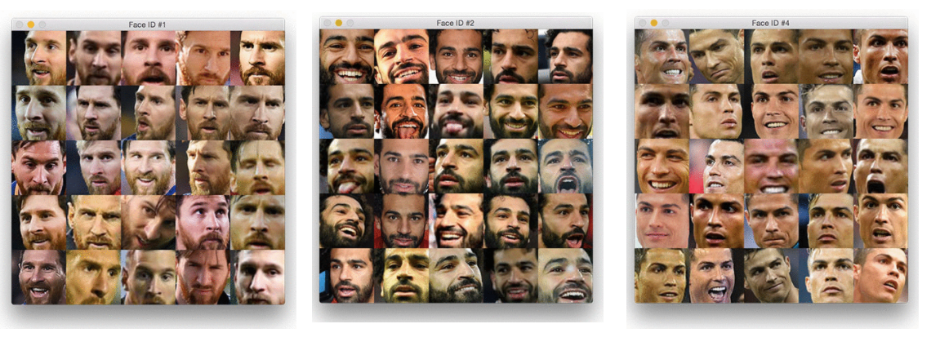
Unsupervised Learning Examples:
Clustering
Grouping similar images together

Slide 30



Types of machine learning: (3) Reinforcement Learning
simulation
Inside a simulation: An agent learns a task by interacting with the environment using trial and error

Slide 31
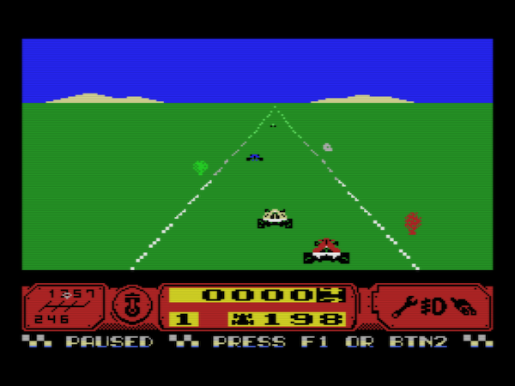
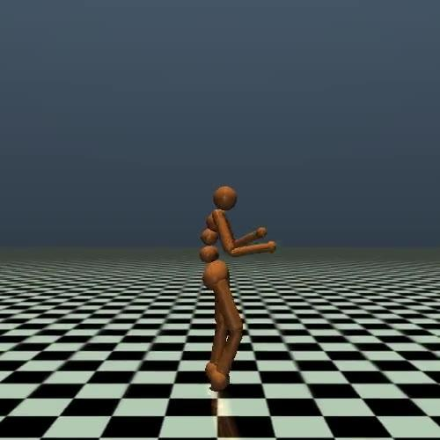
Reinforcement Learning Examples:
Learning to play a game
Learning how to walk

Slide 32
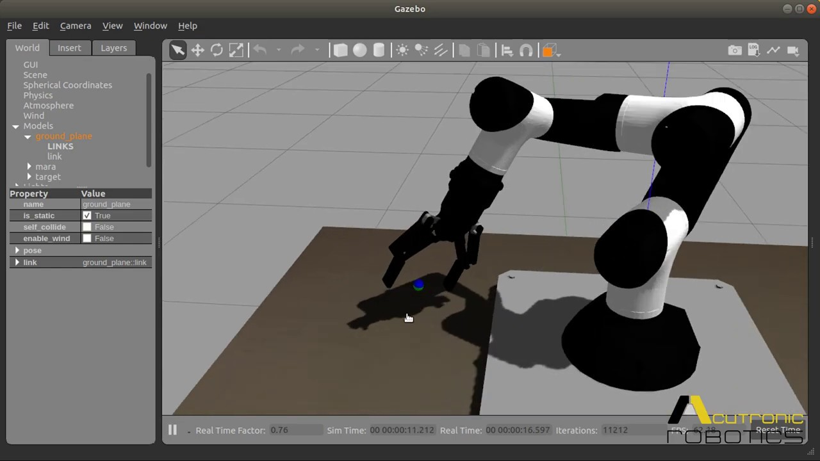

Reinforcement Learning Examples:
Learning to control a robotic arm
Autonomous drone

Slide 33
Dataset (Structured data)
Inputs (features/attributes)
desired output (target)
house age | distance to nearest MRT Station | Convenience Stores | price per unit area
32 | 84.88 | 10 | 37.9
19.5 | 306.59 | 9 | 42.2
13.3 | 561.98 | 5 | 47.3
5 | 390.57 | 5 | 54.8
7.1 | 2175.03 | 3 | 32.1
Each row is called sample,
or instance,
or pattern
Examples of structured data: Excel files or SQL databases

Slide 34




Unstructured data

Slide 35
Machine Learning Models (examples)
Linear/Non-linear regression
Logistic regression
Naïve Bayes Classifier
K Nearest Neighbors
Decision Tree
Random Forest
Support Vector Machine
Ensemble Models
Neural Network

Slide 36





Machine learning engineering
Understanding objective
Building machine learning model
Model deployment
Model testing

Slide 37
Getting dataset

Slide 38
We can download free data from
UCI Machine Learning Repository: https://archive.ics.uci.edu/ml/datasets.php
Kaggle datasets: https://www.kaggle.com/datasets
Google dataset search: https://datasetsearch.research.google.com/

Slide 39
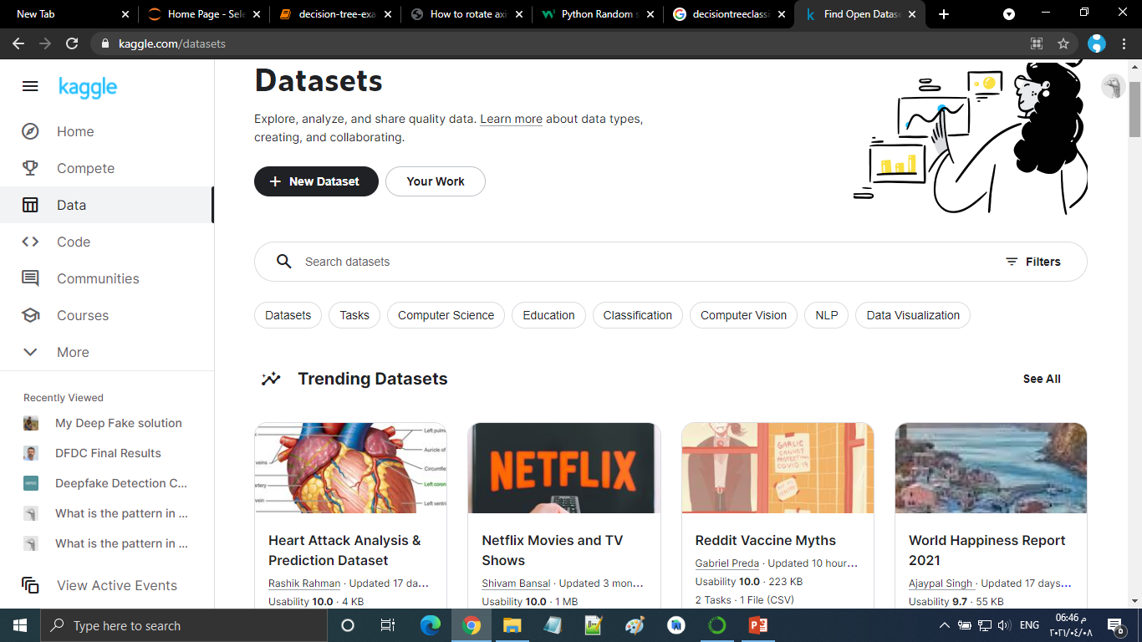
Kaggle datasets

Slide 40


Slide 41
